Slide 1
Sales Prediction Dataset
By – Nikhil Nair

Slide 2
SOME INSIGHTS GAINED

Slide 3
The average amount spent on TV advertising is: $147.04

Slide 4
Correlation between radio advertising expenditure and product sales is: 0.35

Slide 5
Advertising medium with the highest impact on sales is: TV

Slide 6
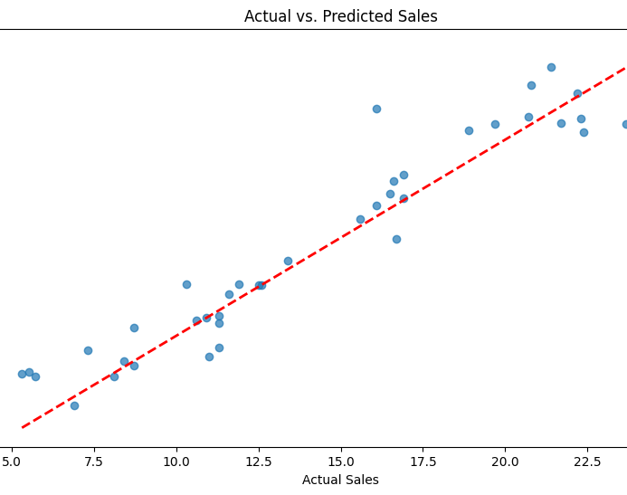
Actual vs. Predicted Sales (after Regression fitting)

Slide 7
Model score on normalized data: 0.91

Slide 8
Model score when only Radio and Newspaper are used as predictors: 0.11

